Slide 1
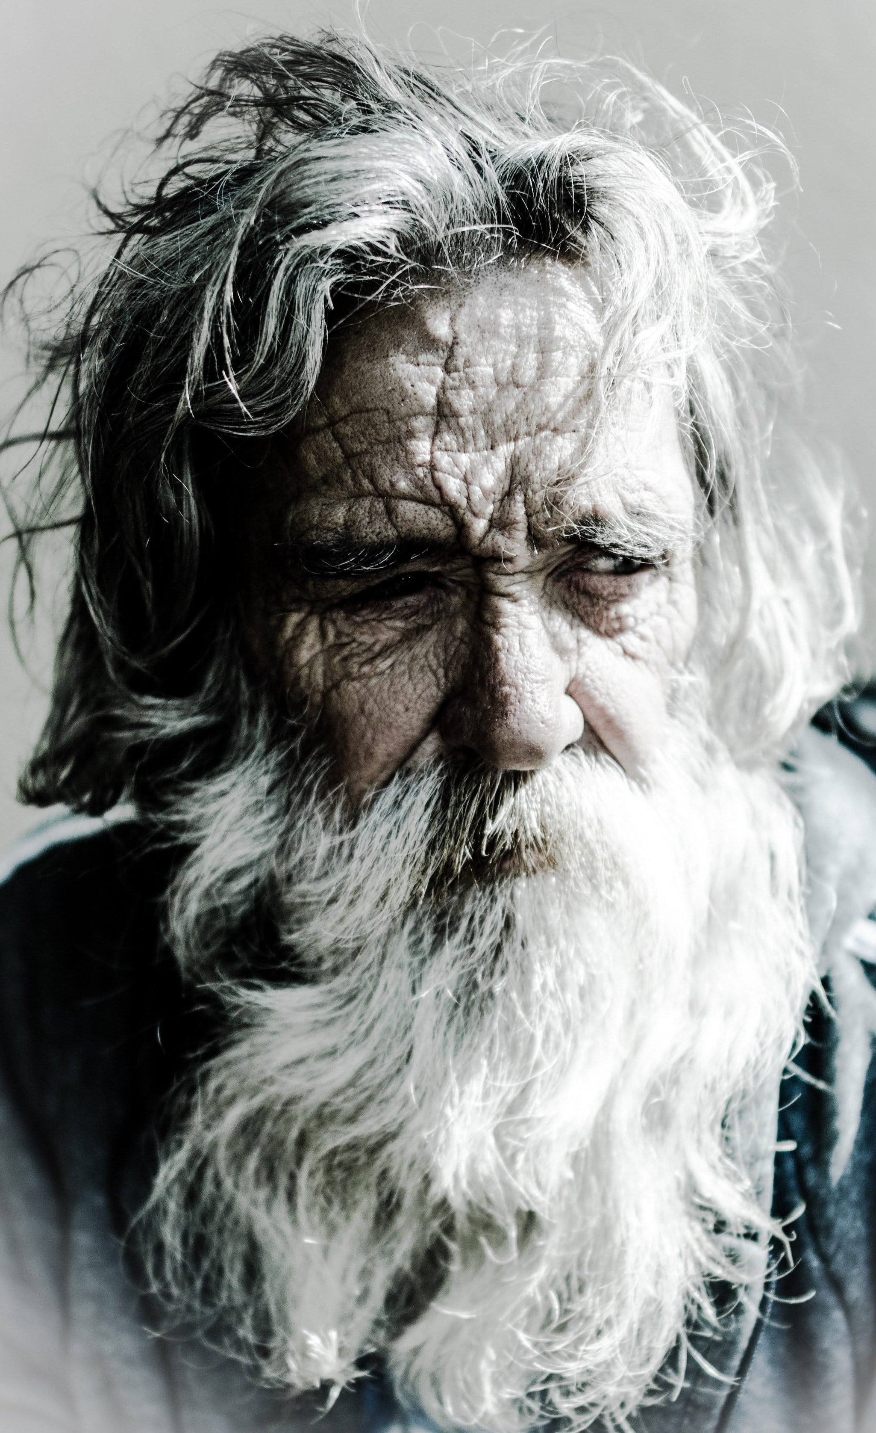
‘Beauty from Ashes’
Jeremiah 31:7-20 Matthew 2:16-18
‘There is hope for your future, declares the LORD, and your children shall come back to their own country.’ Jeremiah 31:17

Slide 2
‘Beauty from Ashes’
- A Cruel Captivity
- A Merciful Migration - A Relationship Restored
‘There is hope for your future, declares the LORD, and your children shall come back to their own country.’ Jeremiah 31:17
Jeremiah 31:7-20 Matthew 2:16-18

Slide 3
‘Beauty from Ashes’
- A Cruel Captivity
‘There is hope for your future, declares the LORD, and your children shall come back to their own country.’ Jeremiah 31:17
Jeremiah 31:7-20 Matthew 2:16-18

Slide 4
‘Beauty from Ashes’
- A Cruel Captivity
- A Merciful Migration
‘There is hope for your future, declares the LORD, and your children shall come back to their own country.’ Jeremiah 31:17
Jeremiah 31:7-20 Matthew 2:16-18

Slide 5
‘Beauty from Ashes’
- A Cruel Captivity
- A Merciful Migration - A Relationship Restored
‘There is hope for your future, declares the LORD, and your children shall come back to their own country.’ Jeremiah 31:17
Jeremiah 31:7-20 Matthew 2:16-18

Slide 6
‘Beauty from Ashes’
Jeremiah 31:7-20 Matthew 2:16-18
‘There is hope for your future, declares the LORD, and your children shall come back to their own country.’ Jeremiah 31:17

